Slide 1


Lifecycle model update
November 2023
Commercial in confidence © Copyright Wilson A.I. Pty Ltd 2021

Slide 2


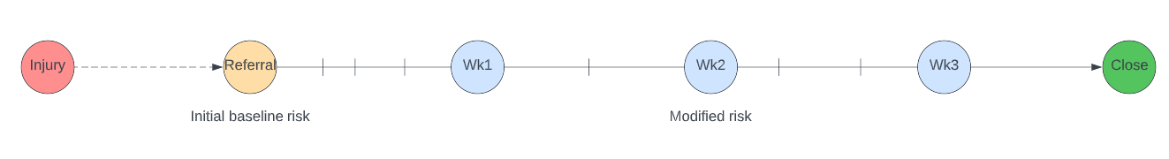
Lifecycle model design
General idea: measure “effort” at certain milestones and see if they’re predictive of risk.
When is a good time to expect such milestones? Week 2? 4? 8? 20? (we can see what the data says…)
Using timesheet data (cost & duration) to estimate “effort”
Categorise effort at high level, eg “assessment”, “travel”, “communication”, “other”
But ideally categorise more granularly, eg “GP”, “Physio”, “Psych”, etc…
Commercial in confidence © Copyright Wilson A.I. Pty Ltd 2021

Slide 3
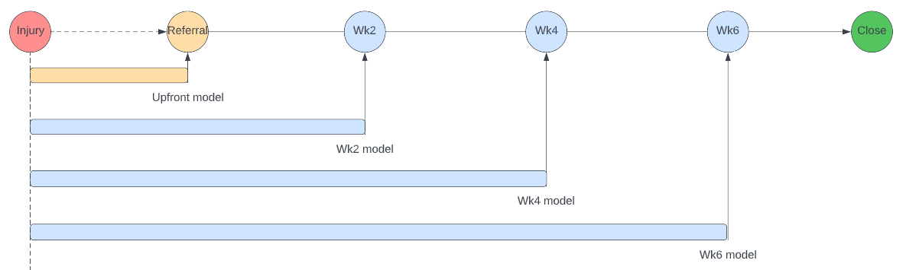
Modeling approach
Approach:
Build a separate model for each milestone
Taking into account everything up to that milestone
Predicting whether there will be a positive outcome
Comparing the prediction with the original upfront prediction
Specifically looking for any impact from the “effort” since referral
Also comparing the milestones to each other
Conclusions from Nov/Dec 2022:
There's always an impact from using the effort to predict the outcome! ie at every milestone.
When is the biggest impact varies between the low-risk vs high-risk groups
Also the factors are different between the groups and the milestones
Commercial in confidence © Copyright Wilson A.I. Pty Ltd 2021

Slide 4
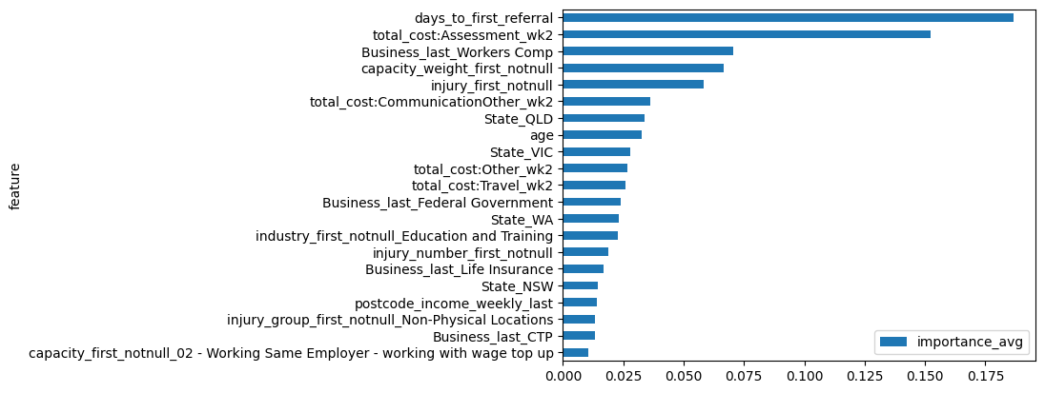
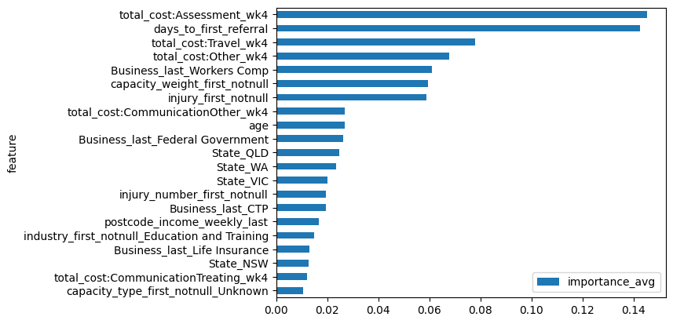
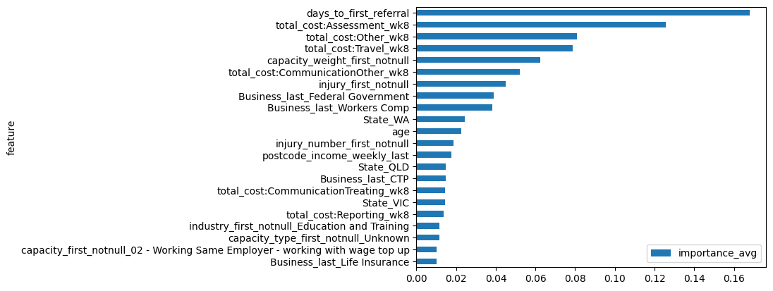
Factors for the lifecycle model
Week-2
Week-4
Week-8
Assessment effort is important in the early few weeks, then travel and general case management (“other”) become important
Commercial in confidence © Copyright Wilson A.I. Pty Ltd 2021

Slide 5
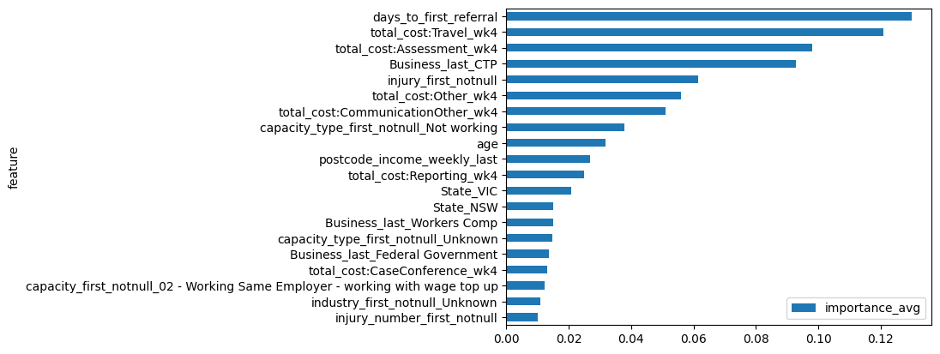
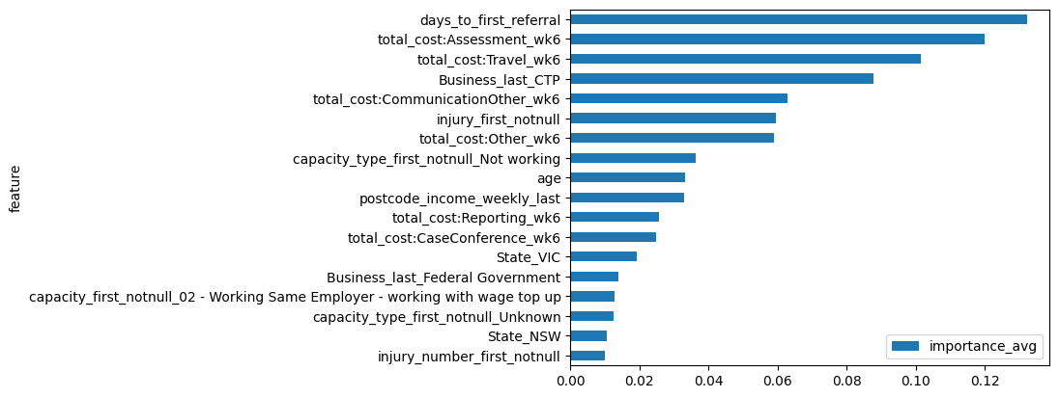
High-risk group
Week-4
For the high-risk group, travel is just as important as assessment!
Week-6
Commercial in confidence © Copyright Wilson A.I. Pty Ltd 2021

Slide 6
Findings so far
Experimental activity | Results Nov/Dec 2022 | Now
1. Looked at weeks 2, 4, 6, 8, 12, 16, 20 as milestones | Generally weeks 4 & 6 are the most predictive But depends on risk group (see below). | All milestones are predictive The earlier weeks have a slight edge
2. Effort measured using: Cost Time Number of activities Weekly activity score = number of weeks where there was least 10 minutes logged, divided by the total number of weeks available (10 minutes is based on analysis). | There is no noticeable difference between cost and time (they are highly correlated). But both are more predictive than number of activities and the weekly activity score. | Have only looked at cost, but don’t expect a different conclusion, unless the hourly rates are vastly different.
Commercial in confidence © Copyright Wilson A.I. Pty Ltd 2021

Slide 7
Findings so far
Experimental activity | Results Nov/Dec 2022 | Now
3. Effort aggregated to overall total, as well as by activity type: Assessment Travel Communication (treating vs other) Case conference Reporting Other (which is the actual case management time) | Breaking the effort down into type definitely improves the model accuracy. “Other” is the most predictive which is good to see. Except at week 2, where “assessment” is more predictive, which makes sense. | Looking into whether the method for getting activity type is accurate Current results suggest that this still improves the model, but only marginally “Assessment” is coming up strong
4. Three different groupings: All claims Low-risk claims (based on upfront risk model) High-risk claims (based on upfront risk model) | It’s certainly useful to look at the risk groups separately, as some of the results above differ by these groups. For the high-risk group, communication seems to be important. For the low-risk group, weeks 6/8 are most predictive, whereas for the high-risk group weeks 10/12 are most predictive. This is intuitive when we recall that high-risk is largely driven by the age of the injury which is typically a few weeks, so there is less of a rush. | Again seeing that the impact differs depending on the risk groups. For the high-risk group, travel and assessment appear equally important. For the low-risk group, assessment dominates in weeks 4/6 and then “other” in week 8.
Commercial in confidence © Copyright Wilson A.I. Pty Ltd 2021

Slide 8
Findings so far
Experimental activity | Results Nov/Dec 2022 | Now
5. Filter out claims with a high percentage of fixed-cost spend | Model accuracy improves | Have kept the filter in, not experimented with removing it.
6. Look at Cost and Duration models | Looked at cost model: can we improve the accuracy using the effort measured at the various milestones. Results show that at most we can improve the accuracy by 3%, which is not sufficient to warrant implementation. More beneficial would be to try to improve the base model Duration model showed similar findings. | The models run ok Haven't experimented further with the settings to see if we can a more significant uplift.
Commercial in confidence © Copyright Wilson A.I. Pty Ltd 2021

Slide 9
Next steps
Assess whether activity type categorisation is valid and repeat the experiments
Discuss whether there are new data points in Vinci regarding the on-going changes in status of a case
Decide whether we want to start working on deployment or continue experimenting.
Commercial in confidence © Copyright Wilson A.I. Pty Ltd 2021

